Slide 1
Kali Linux Commands Practice
Devin Rankin, Parth Patel

Slide 2
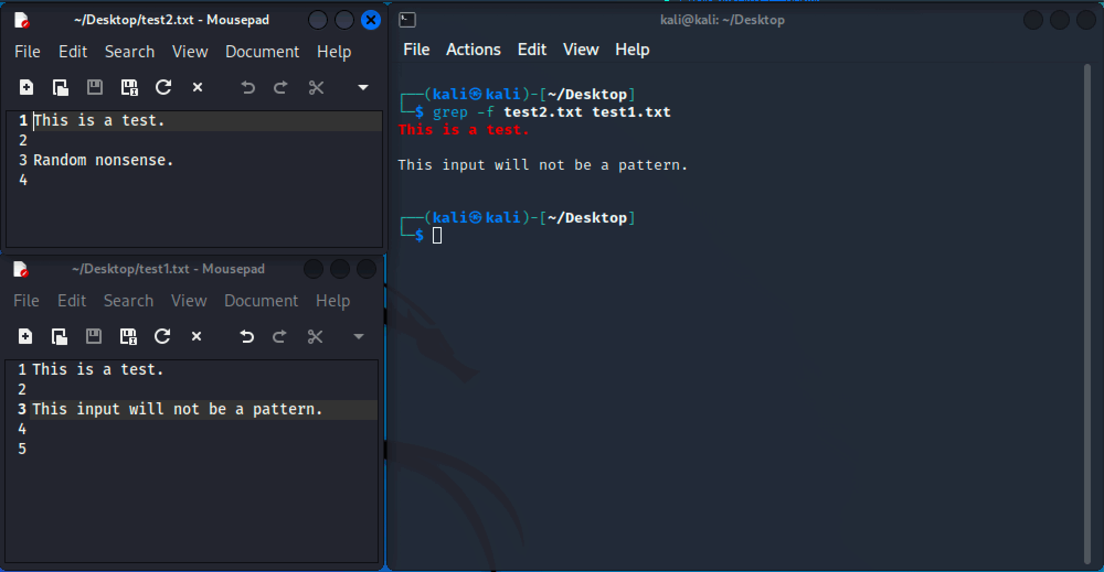
grep [pattern] [file]
grep (global regular expression print) is a useful command used to match regular expressions to a file. It asks for a pattern of text and returns it’s finding to you in the command line.

Slide 3
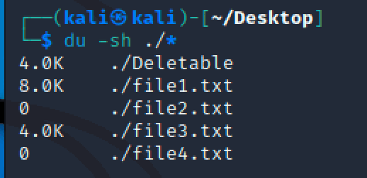
du [arg] [filepath]
du checks the information of disk usage from a given file path. If no file path is given, it just prints the disk usage of the files in the current directory the user is in.

Slide 4
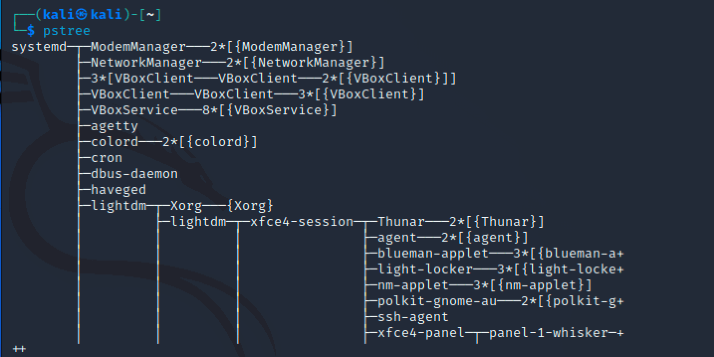
pstree [args]
pstree shows all running processes as a tree, with the root being PID, or init if PID is omitted. A username may also be specified as an argument, in which case pstree will display all processes in a tree currently used by that user.

Slide 5
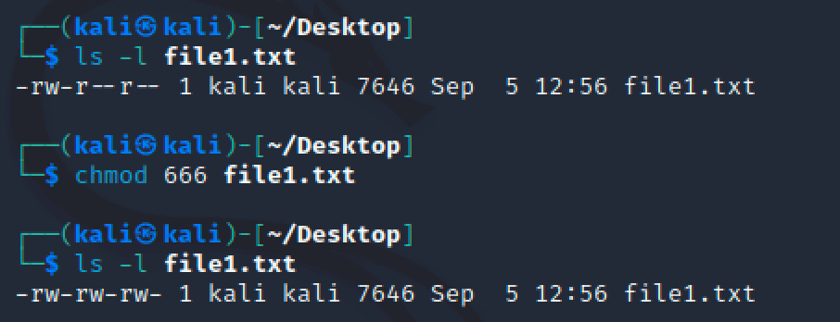
chmod [options][permissions][file]
chmod changes file mode bits, essentially granting or denying permissions to either the user, user’s in the file’s group, others, or all users, depending on options and permissions given.
In this example, chmod 666 file1.txt will change the owner, group, and others file permissions to read & write only.

Slide 6
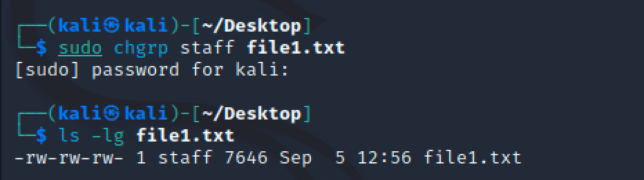
chgrp [options][group file]
chgrp changes the user group of a certain file. A reference may also be used, changing all files to group reference.

Slide 7
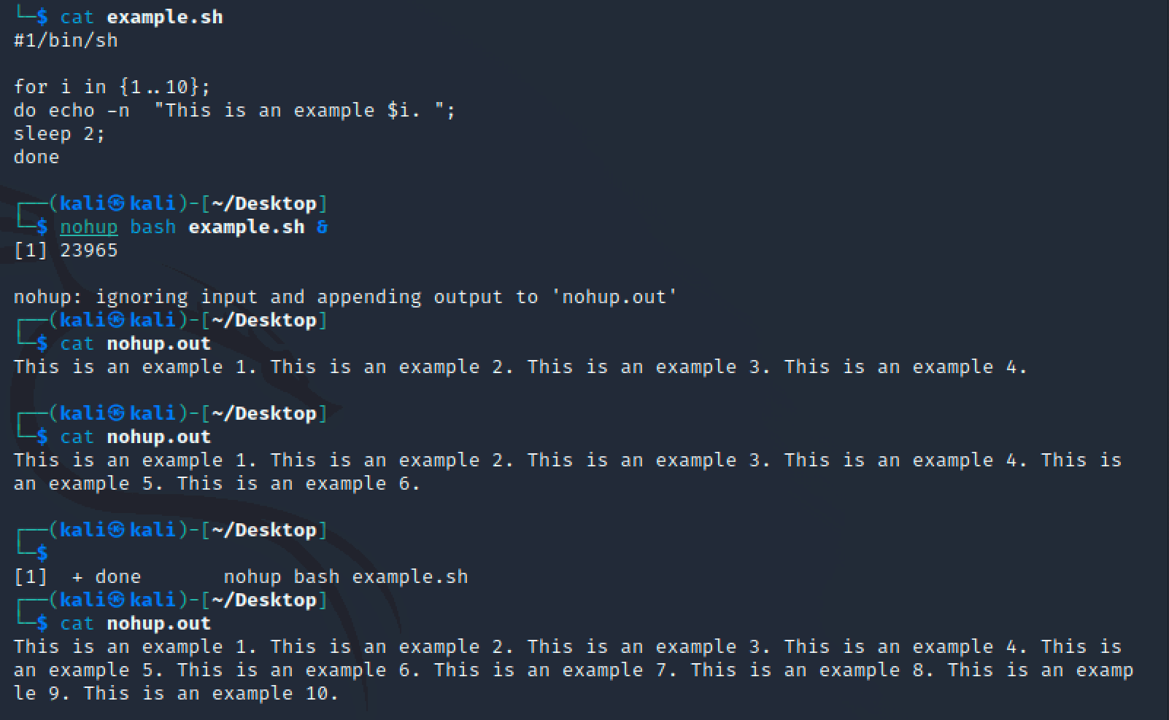
nohup [arg]
nohup runs a process in the background and continues running even after user logout or terminal exit. Unless stated otherwise, the output is stored in a file called nohup.out. The user may also choose to end the script early, by typing fg, or bringing the process to the foreground.

Slide 8
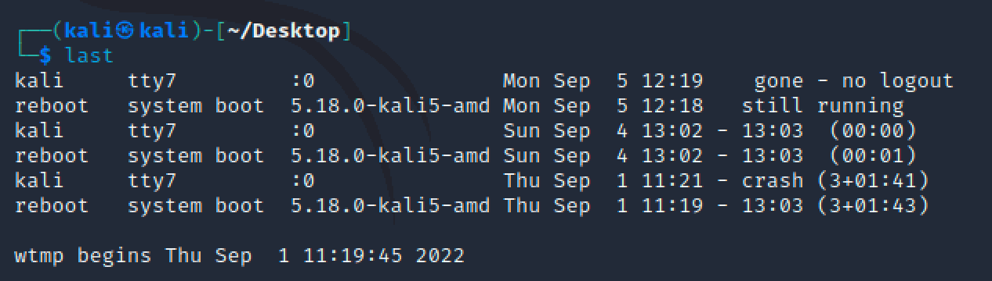
last [arg][username]
last shows a list of the last logged in users, the time they connected, the time they disconnected, and how they disconnected. This is only a list of the users tracked since the /var/log/wtmp file was created.

Slide 9
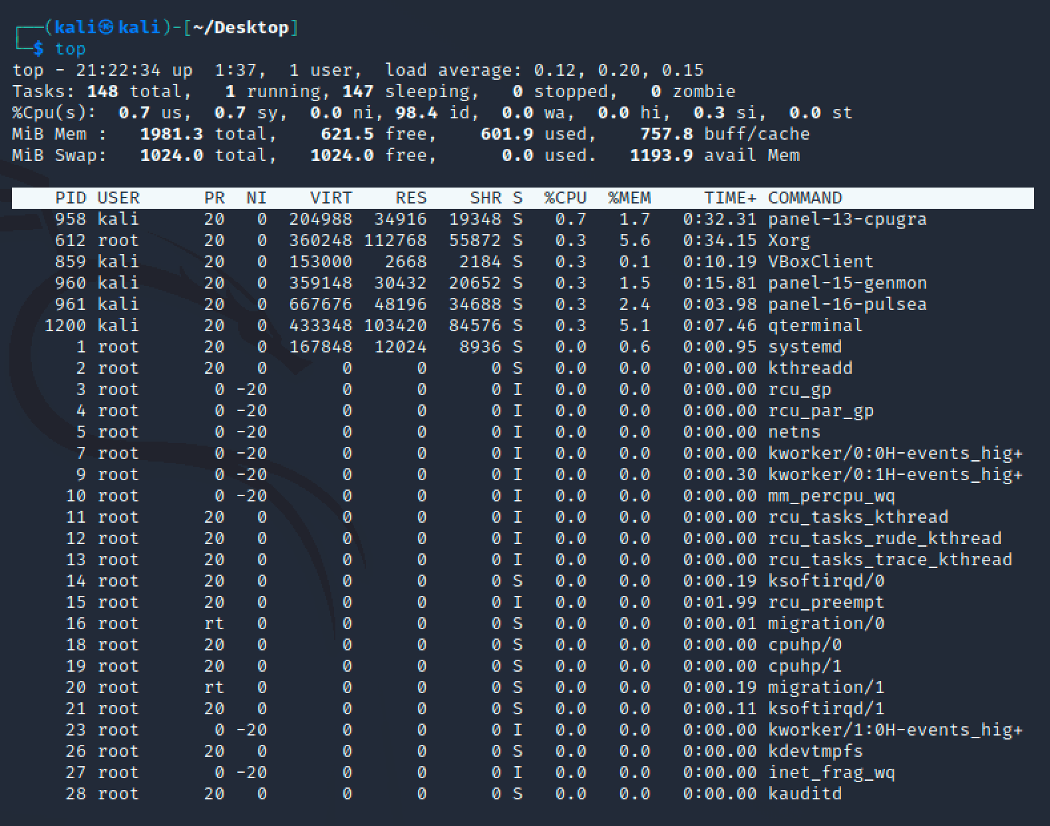
top [arg]
top (table of processes) shows a table of the running processes, displaying a dynamic real-time view of the system. The top half will contain statistics and usages, while the lower is current running processes. Pressing q will exit the command.

Slide 10
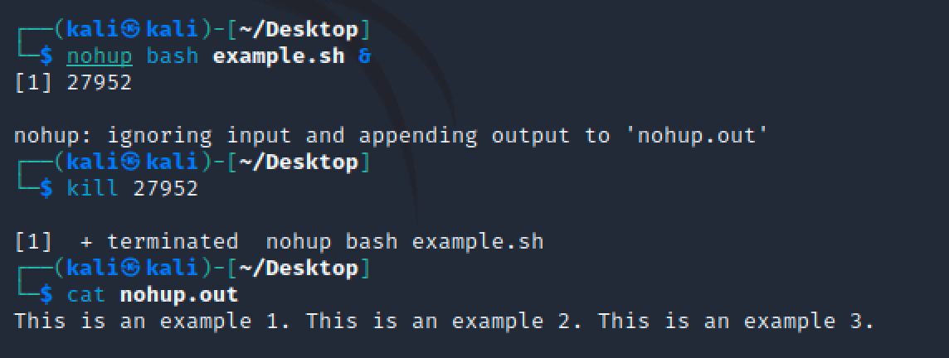
kill [arg][id]
kill simply kills (ends) the running PID or signal given.

Slide 11
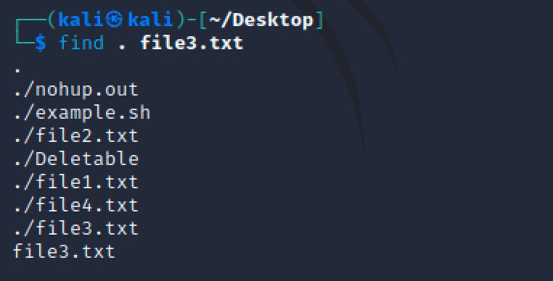
find [arg][starting-point][expression]
find searches the given directory tree rooted at the starting-point for the given expression from left to right according to operator precedence. It searches until an outcome is known. If nothing is found, it moves onto the next directory.

Slide 12
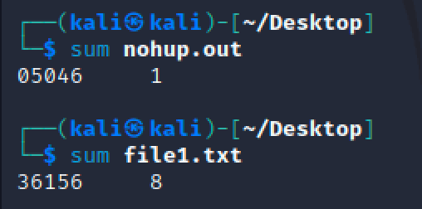
sum [options][file]
sum prints the checksum and block count for the given file. If no file is given, or file is -, reads standard input.

Slide 13
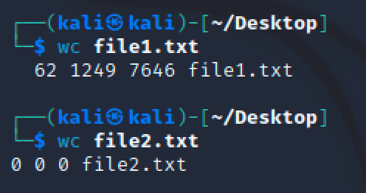
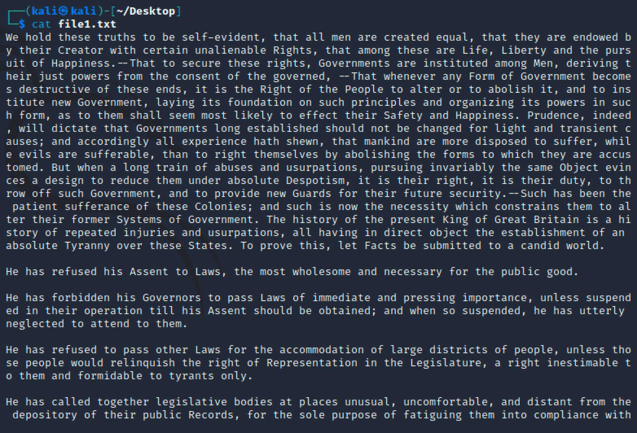
wc [options][file]
wc prints new line, word, and byte counts of a given file, and line count if more than one files are given. If no file is given, or the file is -, reads standard input.

